Slide 1
Brain Tumor Classification Using Deep Learning Algorithms
(Group Id:02)
Ankita Kadam Guide Name:
Sartaj Bhuvaji Mr.Santosh Nagargoje
Prajakta Bhumkar
Sameer Dedge
Notes:
Sameer 1

Slide 2
Contents :
Motivation
Introduction
Literature Survey
Keywords
Objectives
Problem Statement
Scope
Architecture Diagram
Algorithmic Approach
Mathematical Model
System Requirement
Results Expected
Datasets
Conclusion
Reference
Notes:
Sameer 2

Slide 3
Motivation
The WHO classifies Brain Tumor on a scale of Grade I to Grade IV.
The complexity in brain tumor is due to a lot of variations in tumor location and size.
Often times in developing countries the lack of skillful doctors and lack of knowledge about tumors makes it really challenging and time-consuming to generate reports from MRI’s.
Thus automation of this diagnostic process would be helpful.

Slide 4
Introduction :
The tumor classes are Benign (Non - Cancerous) and Malignant (Cancerous).
A Pituitary Tumor is a Benign tumor that starts in the pituitary gland.
This is a 4 class problem.
Our proposed automation system would take an MRI and analyze it to find tumors.
The system would also be able to maintain records of patients and track tumor size.
Cloud deployment and mobile applications provide access to system over the internet.
Notes:
Sameer 3

Slide 5
Problem Statement :
To Detect and Classify Brain Tumor using CNN and ANN as an asset of Deep Learning and to examine change of tumor size.
Notes:
Sartaj 2

Slide 6
Literature Survey :
No | Research Papers/Journal | Authors | Publications | Comments/Analysis/Problems
1 | Deep Learning based brain tumor classification and detection system | Ali Ari, Davut Hanbay | Turkish Journal of Electrical Engineering & Computer Sciences 2018 | ELR-LRM Based Classification
2 | Multi Classification Of Brain Tumor Images | Hossam H. Sultan, Nancy M. Salem, Walid Al-Atabany | IEEE 2019 | CNN Based Classification With Augmentation
3 | Brain Tumor Segmentation Using Deep Learning by Type Specific Sorting of Images | Zahra Sobhaninia, Safiyeh Rezaei, Alireza Noroozi, Mehdi Ahmadi, Hamidreza Zarrabi, Nader Karimi, Ali Emami, | ResearchGate 2019 | Sorting Of Images 1. Sagittal View 2.Axial View 3.Coronal View
4 | Brain Tumor Classification Using Convolutional Neural Networks | J. Seetha, S. Selvakumar Raja | Biomedical & Pharmacology Journal, September 2018. | CNN Based Classification
Notes:
Sameer 4

Slide 7
Keywords:
NN : Neural Network
MRI : Magnetic Resonance Imaging
CNN : Convolution Neural Network
ANN : Artificial Neural Network
AWS : Amazon Web Services
Notes:
Sameer 5

Slide 8
Objectives :
To identify tumor present in MRI.
Segregate the tumor into different type using ANN and CNN algorithms.
To compare accuracies of multiple ANN, CNN models.
To select and deploy the best algorithmic model.
To build robust android/ios applications for easy access.
To maintain patient records for further analysis.
Notes:
Sartaj 1

Slide 9
Scope of Project :
Build models using ANN and CNN algorithms.
Compare those models over various parameters.
Selecting best algorithm for MRI classification.
Display of growth or shrinkage of Tumor.
Reduction in Medical Negligence or Human Error.
Notes:
Sartaj 3

Slide 10
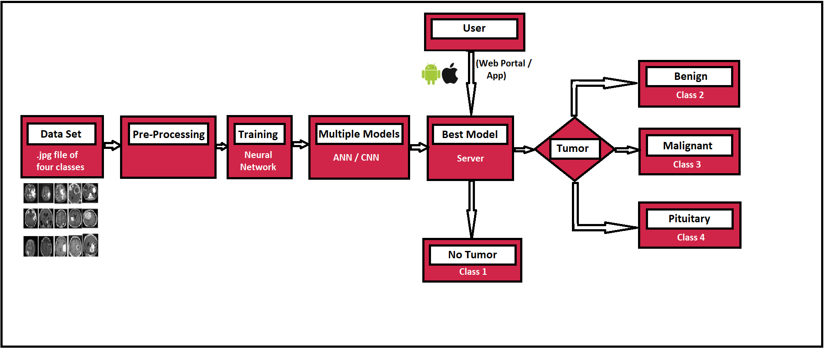
Architecture Diagram:
ANN
CNN
Notes:
Sartaj 4

Slide 11
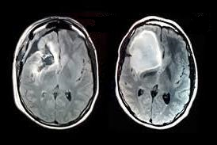

PC
-growth
-shrinkage
-same
Changes in tumor
-account
-old_tumor image
User
Model
Android/
IOS App
Figure: Continuation of Architecture Diagram
Notes:
Sartaj 5

Slide 12
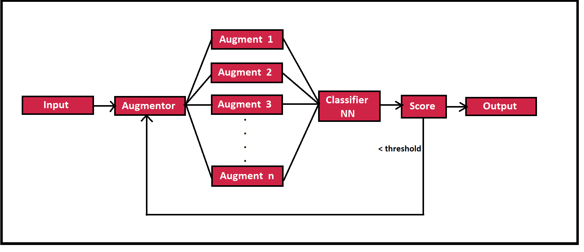
Model Architecture :
The model gets MRI as input. It augments the image into ’n’ different images.
The ’n’ different images are fed to the Neural Network for classification.
The network classifies images into four classes. Then we take votes from each class. If vote is greater than threshold vote confidence, we declare that class label as the output.
If the threshold is not met, generate new ’n’ images and they are again sent to NN.
This process is executed until, the threshold vote confidence is met or no of tries(’t’) is reached..

Slide 13
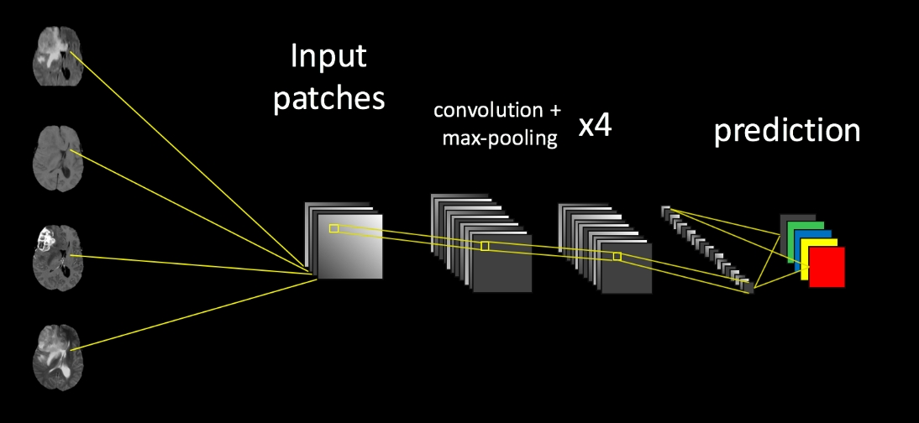
Figure : Abstract Structure of model
Notes:
Sartaj 6

Slide 14
Algorithmic Approach :
Pre Processing Stage.
Model Design Stage.
ANN Model Structure and it’s Hyper-Parameters tuning.
CNN Model Structure and it’s Hyper-Parameters tuning.
Create mobile applications.
Testing.
Deployment.
Notes:
Sartaj 7

Slide 15
Consider the Images, can you classify them?
Notes:
Ankita 1

Slide 16
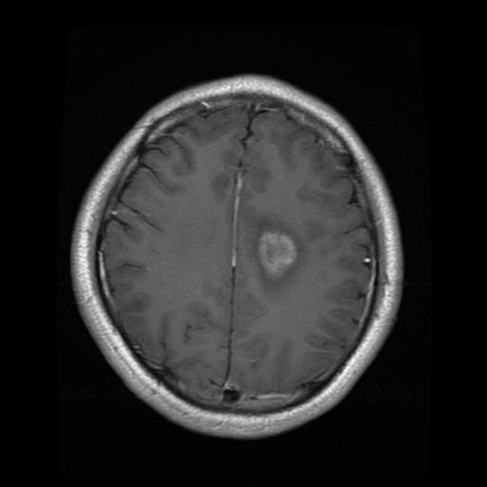
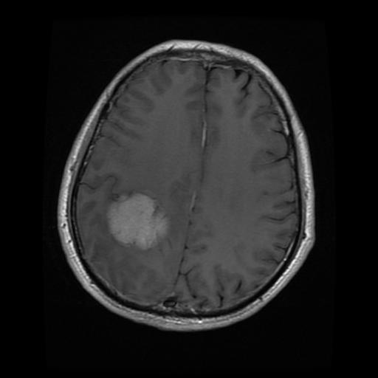
Classifying Tumor Example :
Notes:
Ankita 2

Slide 17
Glioma.
(Cancerous)
Meningioma
(Non - Cancerous)
Notes:
Ankita 3

Slide 18
PRE - Processing Stage:
Gray Scaling
Reduce the images to gray spectrum.
Helps reduce complexity of images.
Resizing
Resizing the images to lower resolution.
Helps reduce all images to an uniform dimension.
Augmentation
Generating multiple images from a single image.
Helps create more data set for training.
Edge Detection
Using edge detection algorithms like Canny, Prewitt.
Helps highlight tumor part in image.
Notes:
Ankita 4

Slide 19
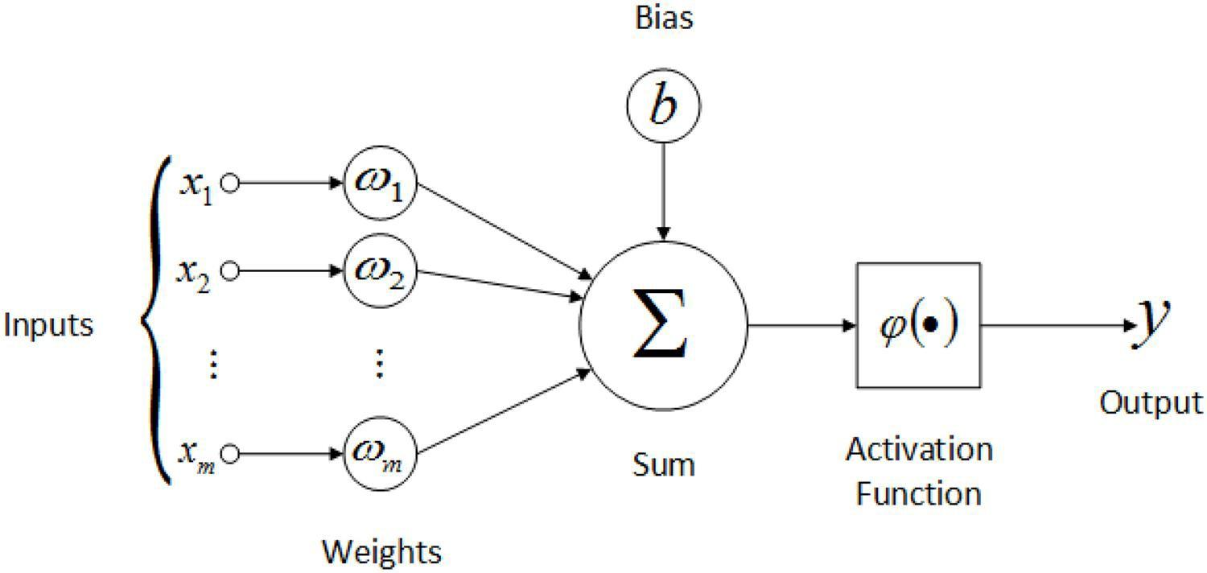
ANN Model Design and its parameters.
Structure
The number of hidden layers, neurons in each hidden layers.
The activation function - To provide non linearity.
ReLu
Sigmoid
Tanh
Learning Rate
The amount that the weights are updated during training is referred to as learning rate.
Generally between 0.3 - 0.0001
Optimizer
To minimize loss function.
Notes:
Sartaj 8

Slide 20
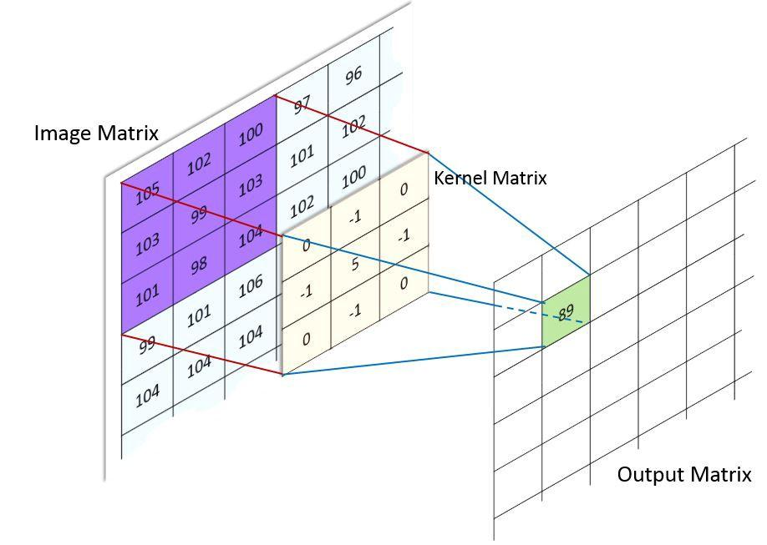
CNN Model Design and its parameters.
Structure
Similar to ANN with addition of Convolution and Pooling .
Convolution
It is a kernel filter for feature extraction.
Provides a pooled feature map.
Pooling
Its a function to reduce the amount of parameters in network.
Notes:
Sartaj 9

Slide 21
Deployment And Use Case:
Server
Amazon Web Services
Paper Space
Device Compatibility
Computer / Laptop
iPhone / Android Smartphones
Clients
Doctors
For validation of tumor class.
To monitor Tumor growth or shrinkage.
Patients
To keep account of multiple MRI.
To check on available hospitals, doctors , medicines.
Notes:
Sameer 6

Slide 22
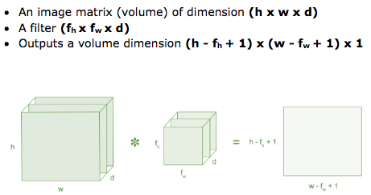
Mathematical Model
Convolution
Notes:
Sameer 7

Slide 23
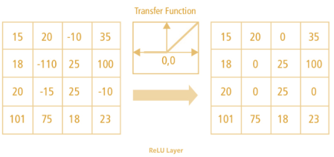
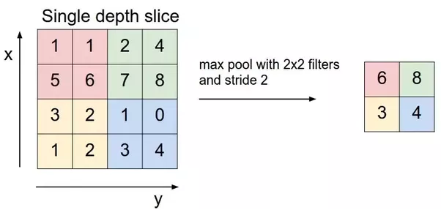
2.ReLU
The output of relu is f(x) =
3. Max Pooling
The output of max pooling is
f(x) = max
0 if x<0
X if x>=0
x[m,n])
Notes:
Sameer 8

Slide 24
System Requirements
Software Specifications:
1 . Anaconda Navigator (v5.3.0)
2. Jupyter Notebook (v6.0.1)
3. Python (3.7)
4. Google Colab
5. Android Studio (v3.5)
6. Swift Studio (v4.1)
Hardware Specifications:
1. Graphic Card : Nvidia’s Titan(12 GB RAM), Tesla K80(12 GB RAM)
2. CPU:Intel
3. RAM : 16 GB(DDR3)
4. Other: Network Card.
5. iPhone/ Android phone
Notes:
Ankita 5

Slide 25
Server Specifications:
AWS:
GPU : 1 X NVIDIA Tesla V100
CPU : INTEL 8 Core
GPU MEMORY : 16 GB
MEMORY : 61 GB
COST : 3.06$/hr
Paper Space
GPU : 1 X NVIDIA Quadro 4000
CPU : INTEL 8 Core
GPU MEMORY : 8GB
MEMORY : 30GB
COST : 0.51$/hr
Notes:
Ankita 6

Slide 26
Results Expected
To achieve an accuracy greater than 96% in segmentation of MRI using CNN and/or ANN.
Selecting best hyper-parameters for selected model.
The records of patients should be maintained.
The model should be able to accurately predict the growth or shrinkage of tumor by comparing the new MRI with old MRI.
Notes:
Ankita 7

Slide 27
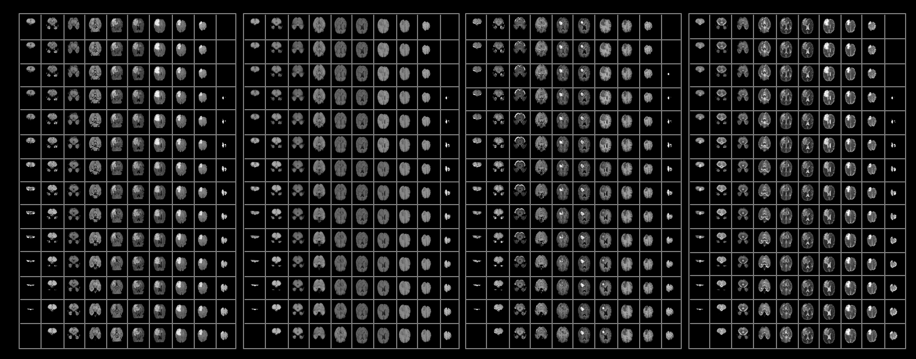
Data Sets
Github - Swati707 : Brain Tumor Classification Dataset
https://github.com/Swati707/brain-tumor-classification/tree/master/Datasets
Kaggle : Brain Tumor Image Dataset
https://www.kaggle.com/navoneel/brain-mri-images-for-brain-tumor-detection
Notes:
Ankita 8

Slide 28
Conclusion
Best of CNN/ANN model with highest accuracy is selected for deployment.
The best possible NN architecture for the automation of classification of brain tumor MR images into 4 classes :No Tumor, Benign, Malignant and Pituitary tumor is studied.
Notes:
Ankita 9

Slide 29
References
“Brain Tumor Classification Using Convolutional Neural Networks” by J. Seetha and S.Selvakumar Raja,2018
http://biomedpharmajournal.org/vol11no3/brain-tumor-classification-using-convolutional-neural-networks/
“Brain Tumor Segmentation with Deep Neural Networks” by Mohammad Havaei , Axel Davy , David Warde, Antoine Biard, Aaron Courville ,Yoshua Bengio ,Chris Pal ,Pierre-Marc Jodoin, Hugo,2015
https://paperswithcode.com/paper/brain-tumor-segmentation-with-deep-neural
“Deep learning based brain tumor classification and detection system” by ALI ARI and Davyut
Hanbay ,2018
https://journals.tubitak.gov.tr/elektrik/abstract.htm?id=23203
“A Review on Automated Brain Tumor Detection and Segmentation from MRI of Brain” by Sudipta
Roy,Sanjay Nag , Indra Kanta Maitra , Prof. Samir Kumar Bandyopadhyay.
https://www.pdffiller.com/jsfiller-desk14/?projectId=342656350&expId=5621&expBranch=1#c12efbf3b0dcd5ed66d7e3d5ca6bb597
Machine Learning with python - sentdex
https://www.youtube.com/watch?v=wQ8BIBpya2k&list=PLQVvvaa0QuDfhTox0AjmQ6tvTgMBZBEXN
“Diagnosing and Segmenting Brain Tumors and Phenotypes using MRI Scans” by Samuel Teicher and Alexander Martinez,2014
http://cs229.stanford.edu/proj2014/Samuel%20Teicher,%20Alexander%20Martinez,%20Diagnosing%20and%20Segmenting%20Brain%20Tumors%20and%20Phenotypes%20using%20MRI%20Scans.pdf
Notes:
Ankita 10

Slide 30
Thank you :
We would like to express our gratitude towards our principal Dr. Mrs. K. R Joshi, our respected HOD.(Computer Department) Dr. Mrs. S. A. Itkar and our respected guide Mr. Santosh Nagargoje.
We would also like to thank Mr. Prashant Sahu for the internship full of knowledge.
We would like to thank Dr. Shashikant Ubhe for validating the dataset.
We would like to thank Ms. Swati Kanchan for providing the necessary dataset.

Slide 31
Thank You
Notes:
Ankita

